Slide 1
System Programming lecture IV: macro processor

Slide 2
Contents
Introduction
Basic macro processor Functions
Macro call and subroutine call
Macro Processor Design
Keyword Macro Parameters
Advantage of Macro

Slide 3
Introduction
In an assembly language program can be group of instructions that may be repeated again and again.
So we combine these instruction to a single group and assign a name to it ,which is called as MACRO.
A macro is an extension to the basic ASSEMBLER language.
It provide a means for generating a commonly used sequence of assembler instructions/statements.
The sequence of instructions/statements will be coded ONE time within the macro definition.
Whenever the sequence is needed within a program, the macro will be "called"

Slide 4
Con…
Macros (macroinstruction) can make tasks less repetitive by representing a complicated sequence of keystrokes, mouse movements, commands, or other types of input.
A macro represents a commonly used group of statements in the source program.
A macro instruction (macro) is simply a notational convenience for the programmer.
Using macros allows a programmer to write a shorthand version of a program(module programming).

Slide 5
CON…
A macro processor is a program that copies a stream of text from one place to another, making a systematic set of replacements as it does so.
The macro processor replaces each macro instruction with the corresponding group of source statements.
  This operation is called “expanding the macro”
The functions of a macro processor essentially involve the substitution of one group of lines for another.
  Normally, the processor performs no analysis of the text it handles.
  The meaning of these statements are of no concern during macro expansion.

Slide 6
CON…
Macro processors are often embedded in other programs, such as assemblers and compilers.
Sometimes they are standalone programs that can be used to process any kind of text.
Therefore, the design of a macro processor generally is machine independent.
Macros mostly are used in assembler language programming.
However, it can also be used in high-level programming languages such as C or C++.

Slide 7
Con…
A macro is used for a small number of instructions; mostly, less than ten instructions, while the procedure is used for a large number of instructions
Features of Macro processor:
  Recognized the macro definition.
  Save macro definition.
  Recognized the macro call.
  Perform macro expansion.

Slide 8
Basic macro processor Functions
Two new assembler directives are used in macro definition
  MACRO: identify the beginning of a macro definition
  MEND: identify the end of a macro definition
The macro’s name appears before the MACRO directive.
The macro’s parameters appear after the MACRO directive.
Each parameter begins with ‘&’
Between MACRO and MEND is the body of the macro. These are the statements that will be generated as the expansion of the macro definition.
The macro name and parameters define a pattern or prototype for the macro instructions used by the programmer
Name MACRO Parameters
:
Body
:
MEND

Slide 9
Macro Expansion
A macro invocation statement gives the name of the macro instruction being invoked and the arguments to be used in expanding the macro.
Each macro invocation statement will be expanded into the statements that form the body of the macro
Arguments from the macro invocation substituted for the parameters in the macro prototype.
The arguments and parameters are associated with one another according to their positions.
The first argument corresponds to the first parameter, and so on.

Slide 10
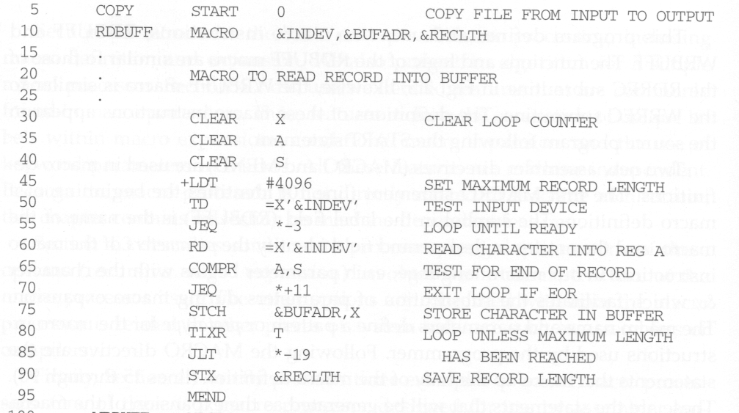
Macro Program Example
Macro Definition

Slide 11
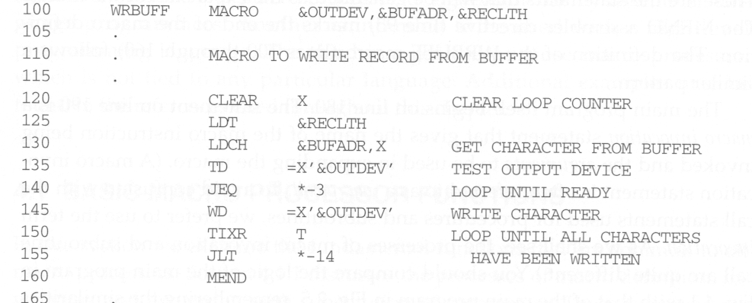
Macro definition

Slide 12
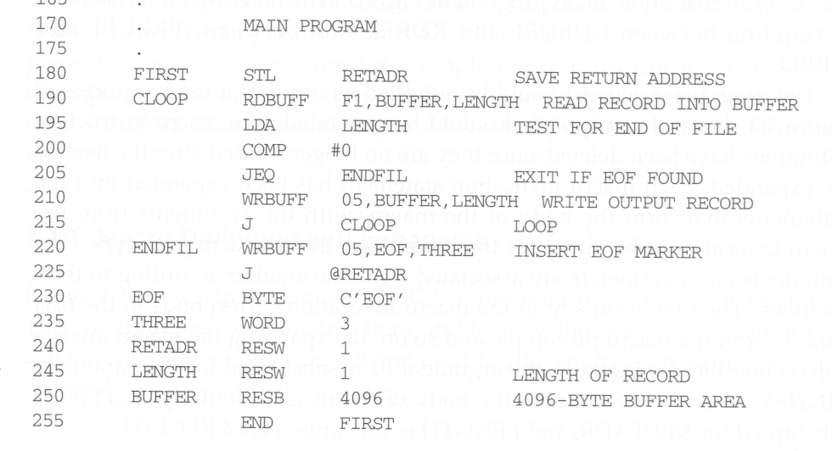
Macro invocations

Slide 13
Con…
A macro definition must come before its invocation in a program.
To ensure this sequence, macro definitions are usually placed at the beginning of a program.
The macro processor replaces each macro instruction with the corresponding group of source language statements.
This is called macro expansion or expanding the macros

Slide 14
Retain Labels on Expanded Macro
The label on the macro invocation statement CLOOP has been retained as a label on the first statement generated in the macro expansion.
This allows the programmer to use a macro instruction exactly in the same way as an assembler language mnemonic.

Slide 15
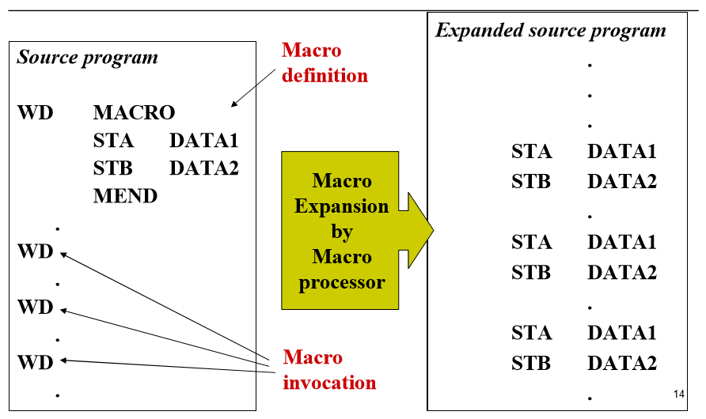
Macro Expansion example

Slide 16
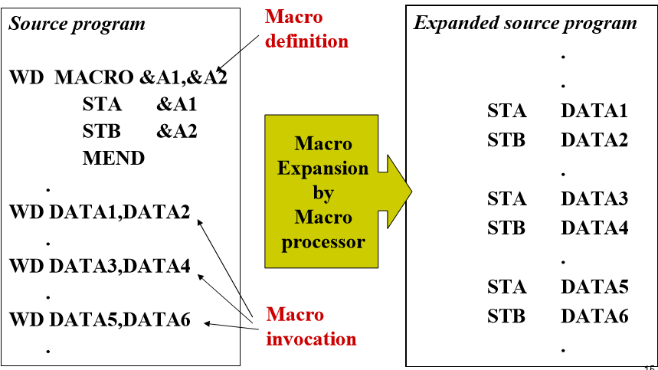
Macro Expansion with Parameters Substitution

Slide 17
Macro and Subroutine
The statements generated from the macro expansions will be assembled exactly as though they had been written directly by the programmer.
Both permit a group of instructions to be defined as a single entity with a unique given label or name called up when needed.
Macros are simple to write and faster than subroutine
The differences between macro invocation and subroutine call
  Macro call: The statements that form the body of the macro are generated each time a macro is expanded. Memory wastage high
  Procedure call: Statements in a subroutine appear only once, regardless of how many times the subroutine is called.
Notes:
A set of Instructions which are used repeatedly in a program can be referred to as Subroutine.
also referred to as a function, procedure, method, and subprogram, is code called and executed anywhere in a program.
For example, a routine may be used to save a file

Slide 18
Macro Processors Design
There are two design option
  One-pass algorithm
  Two-pass algorithm
  One-pass algorithm
  Every macro must be defined before it is called
One-pass processor can alternate between macro definition and macro expansion
is able to handle “macro in macro”.
the definition of a macro must appear in the source program before any statements that invoke that macro.
Nested macro definitions are allowed but not nested call.

Slide 19
Data Structures
DEFTAB(Definition Table)
  Store the definition statements of macros
  Comment lines are omitted.
NAMTAB
  Store macro names, which serves an index to DEFTAB
  Contain pointers to the beginning and end of the macro definition
ARGTAB
  Used during the expansion of macro invocations.
  When a macro invocation statement is encountered, the arguments are stored in this table according to their position in the argument list.

Slide 20
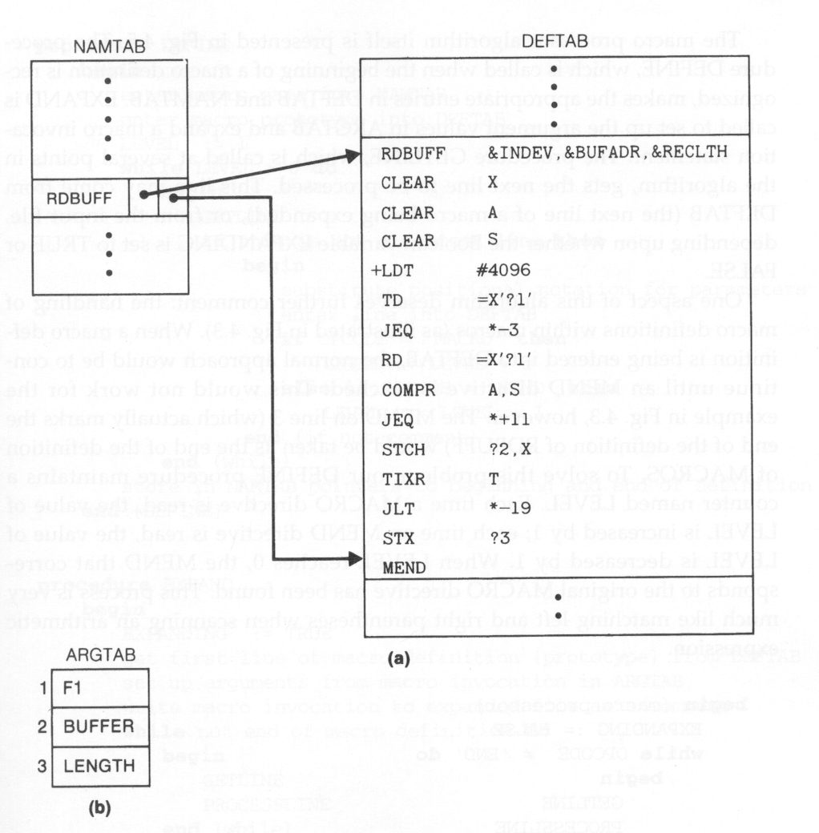
Data Structures Snapshot

Slide 21
  Two-pass algorithm
Like an assembler or a loader, we can design a two-pass macro processor in which
  In pass I , all macro definitions are processed
  In pass II , all macro invocation statements are expanded
However, such a macro processor cannot allow the body of one macro instruction to contain definitions of other macros.
  Because all macros would have to be defined during the first pass before any macro invocations were expanded.

Slide 22
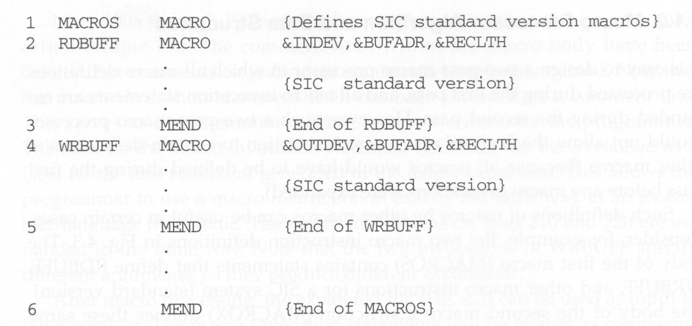
Macro Containing Macro Example

Slide 23
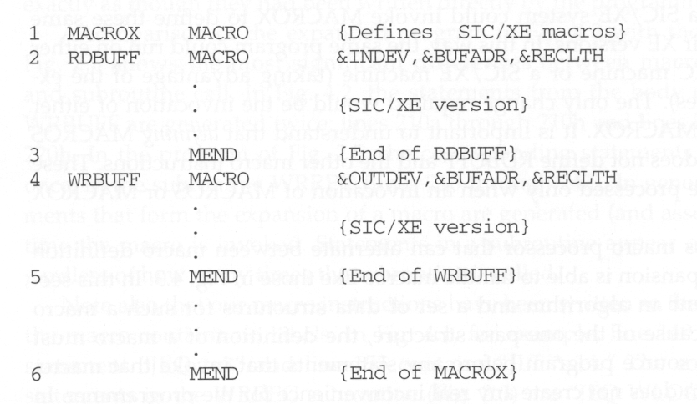

Slide 24
MACROS and MACROX
MACROS contains the definitions of RDBUFF and WRBUFF which are written in SIC instructions.
MACROX contains the definitions of RDBUFF and WRBUFF which are written in SIC/XE instructions.
A program that is to be run on SIC system could invoke MACROS whereas a program to be run on SIC/XE can invoke MACROX.
Defining MACROS or MACROX does not define RDBUFF and WRBUFF. These definitions are processed only when an invocation of MACROS or MACROX is expanded.

Slide 25
Keyword Macro Parameters
So far, all macro instructions use positional parameters.
  If an argument is to be omitted, the macro invocation statement must contain a null argument to maintain the correct argument positions.
If keyword parameters are used, each argument value is written with a keyword that names the corresponding parameters.
  Arguments thus can appear in any order.
  Null arguments no longer need to be used.
  E.g., GENER TYPE=DIRECT, CHANNEL=3
Keyword parameter method can make a program easier to read than the positional method.

Slide 26
Keyword & positional parameters.
Keyword parameters are symbolic parameters that can be specified in any order when the macro is called.
The parameter will be replaced within the macro body by the value specified when the macro is called
Keyword arguments are arguments that can be called by their name
Positional parameters are variables specified in the order of function called.
Positional arguments are arguments that can be called by their position.

Slide 27
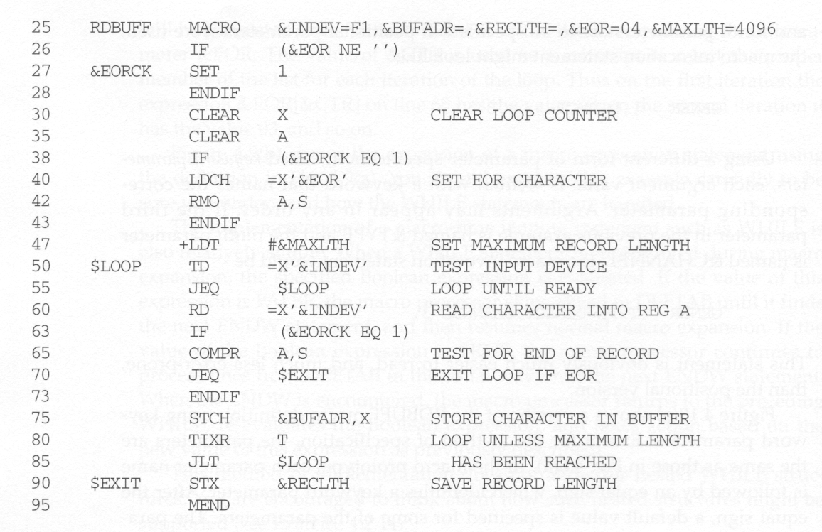
Keyword Macro Example
Can specify default values

Slide 28
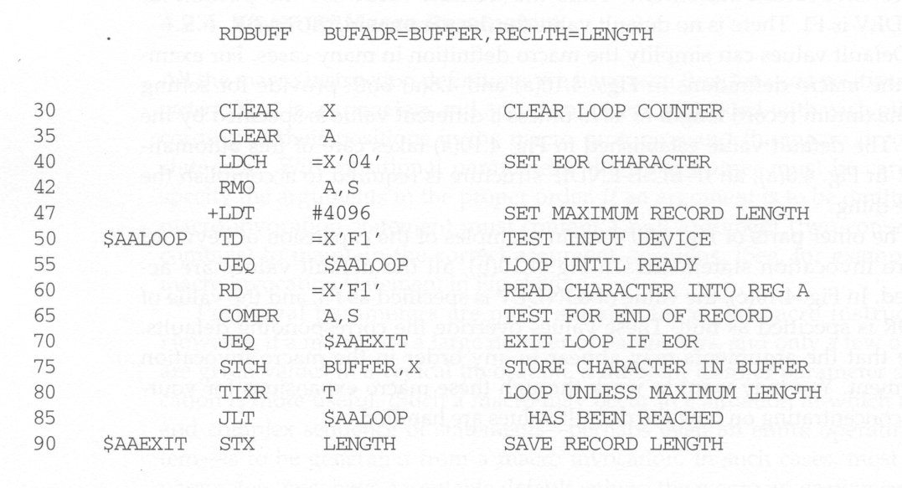
Keyword parameters

Slide 29
Advantage of Macro
A macro is a name given to a block of the code which can be substituted where the code snippet is to be used for more than once.
- The frequent use of macros can reduce programmer-induced errors
-The speed of the execution of the program is the major advantage of using a macro.
- It saves a lot of time that is spent by the compiler for invoking / calling the functions.
- It reduces the length of the program

Slide 30
Thank you!
Question?

